Slide 1
DBMS Project

Slide 2
Project Motivation
Been hired as Lead Database Engineers for a Journal Publication Application
Asked to provide a process to publish Journal Articles
The Application description is provided
Entities were identified
The Database was designed
The data for population was generated
The Database was created
The requested functionalities were implemented

Slide 3
System Description
Register a User
Authenticate a user based on their email
Provide a categorized list of articles
Enrol authors
Request for submission of an Article and assign Reviewers
Release the Article
Initiate the Sales Module/ Table

Slide 4
System Architecture
Mysql used for Database Creation
Queries produced for the functionalities
For User Interface and Application:
Front end would require basic routing and html files for the pages
Backend would have the defined methods for each of the required functionalities
The queries for the tasks would be implemented in a (e.g) python function and the user would be required to fill the inputs of the queries. Those may include their name, role, email, etc., for, in this case, the registering step, which would be added to the Database with the insert query implemented in the function

Slide 5
Database Design
Random Name Generator: https://1000randomnames.com/
Paperell Inspiration: https://paperell.net/blog
Random Phone Number Generator: https://wee.tools/phone-number-generator/

Slide 6
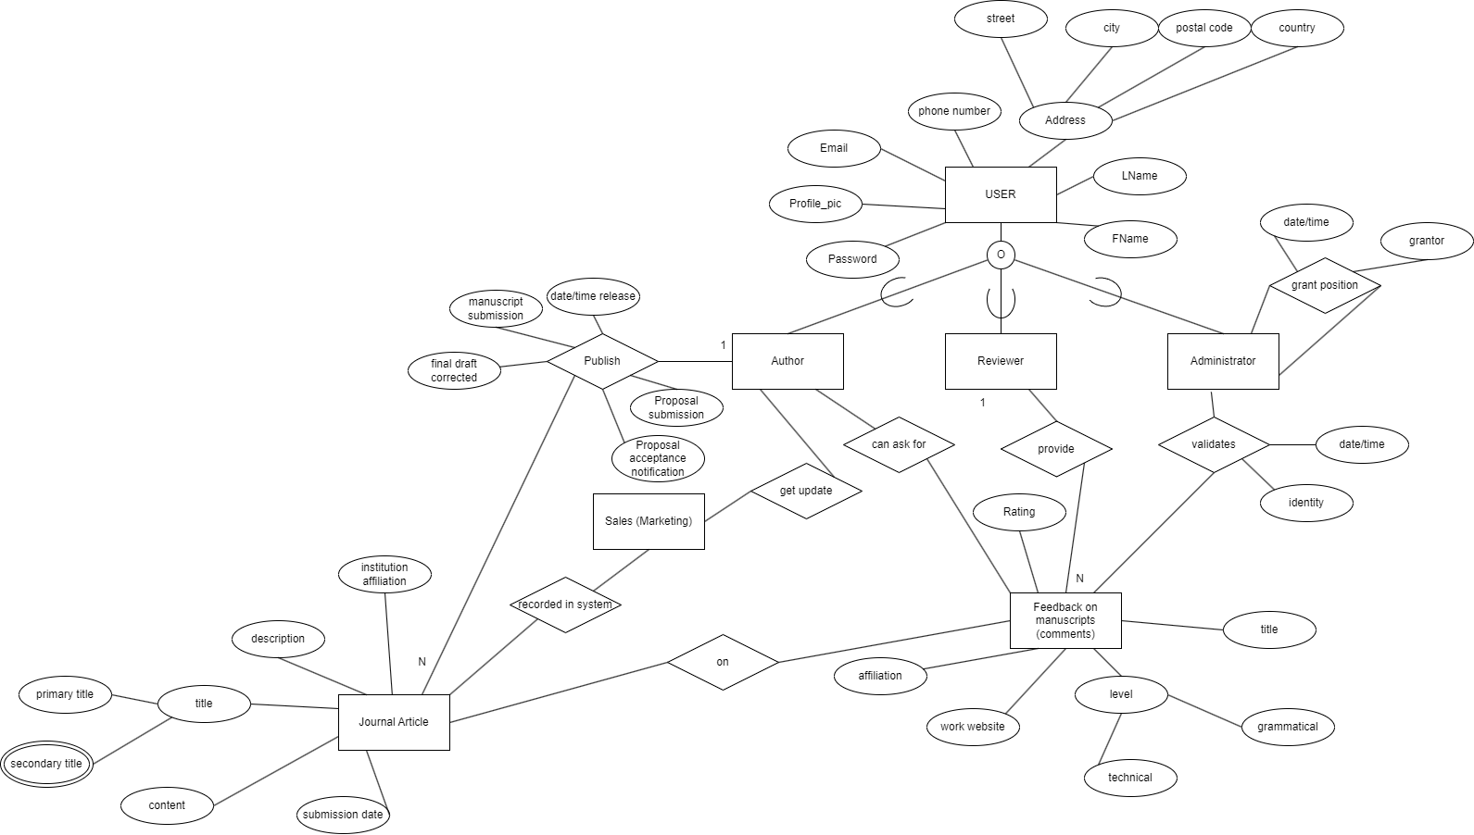
ERD

Slide 7
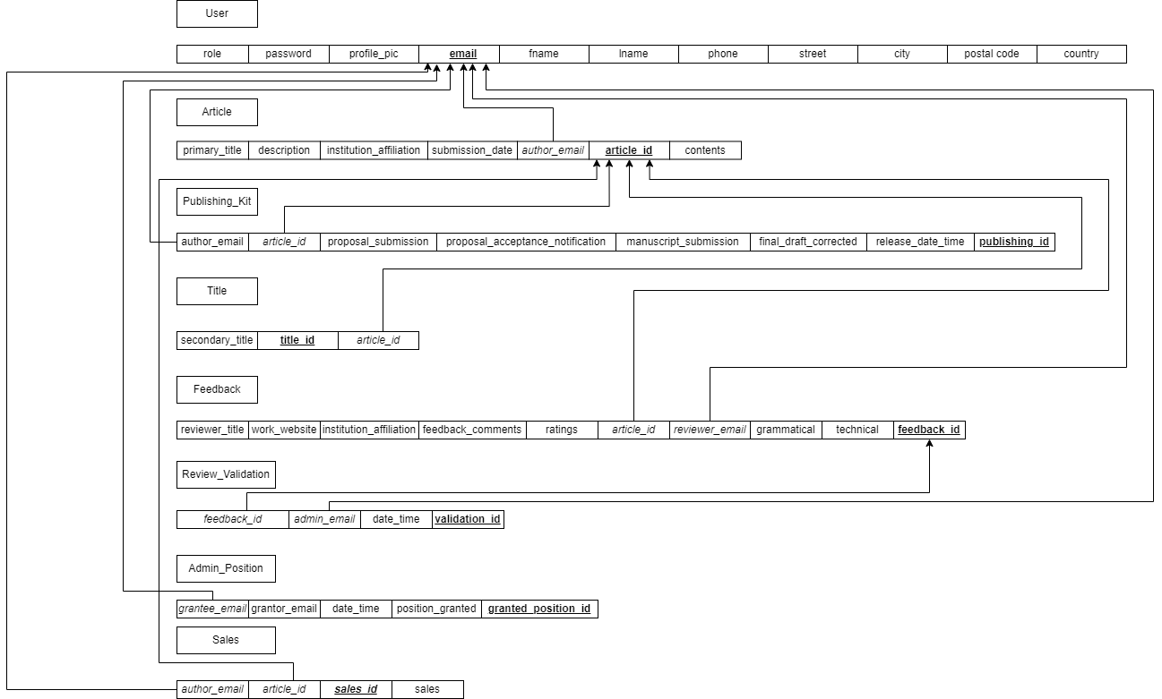
Mapping

